Slide 1

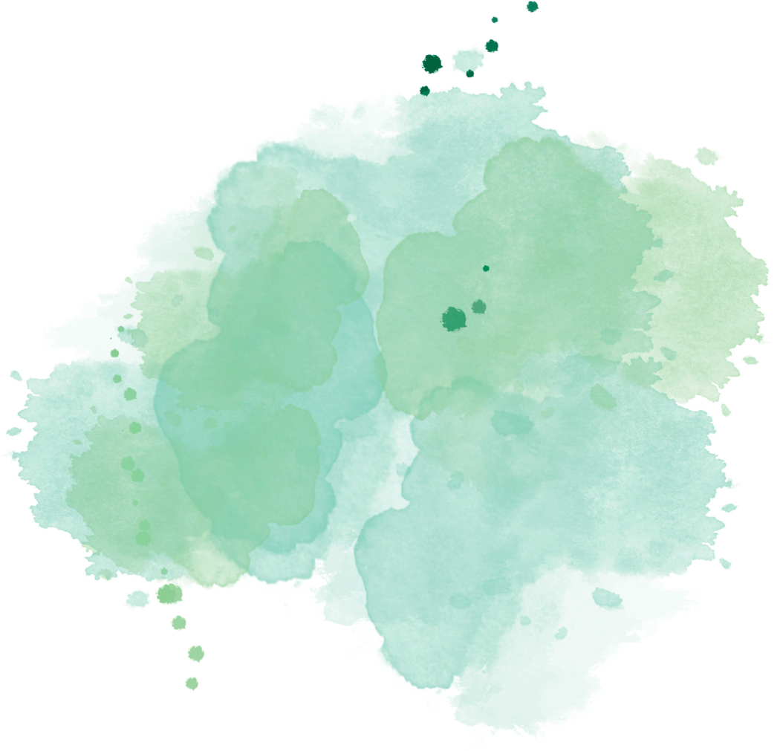






TRANSART: A MULTIMODAL APPLICATION FOR VERNACULAR LANGUAGE TRANSLATION AND IMAGE SYNTHESIS
By
SARAN B

Slide 2
PROJECT GOALS
1.
Develop a web-based application that translates Tamil text to English, generates relevant images, and provides creative text output.
2.
The project demonstrates how AI models can be integrated to provide seamless and interactive content translation and generation, supporting educational and creative applications.

Slide 3
KEY FEATURES
AUDIO TRANSCRIPTION
TEXT-TO-IMAGE GENERATION
1.
3.
USES THE GROQ API FOR TRANSCRIBING AUDIO FILES IN TAMIL, LEVERAGING A MODEL (WHISPER-LARGE-V3) TO PROVIDE ACCURATE TEXT OUTPUT.
THE DEEP TRANSLATOR LIBRARY TRANSLATES TAMIL TEXT TO ENGLISH
THE HUGGING FACE API TO GENERATE IMAGES BASED ON THE TRANSLATED TEXT DESCRIPTION. IT INCLUDES ERROR HANDLING AND RETRY LOGIC TO HANDLE SERVER DELAYS.
2.
CREATIVE TEXT GENERATION
USES THE LLAMA-3.2-90B-TEXT-PREVIEW MODEL TO CREATE RESPONSES BASED ON TRANSLATED TEXT. THIS ALLOWS FOR FURTHER CREATIVE RESPONSES, USING AN LLM FOR CONVERSATIONAL OR DESCRIPTIVE OUTPUT.

Slide 4
CONCLUSION
The TransArt project successfully demonstrates the integration of multimodal AI capabilities within a user-friendly web application. By translating Tamil text into English, generating contextually relevant images, and producing creative written content, the application bridges language and visual communication effectively. This project highlights the utility of modern AI models, including neural machine translation, text-to-image generation, and creative text synthesis, showcasing their potential for educational and content creation purposes.

Slide 5
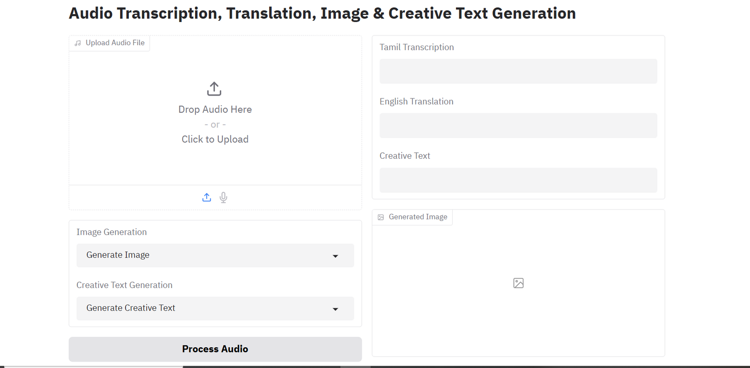
WEB PAGE

Slide 6
PUBLIC LINK
HTTPS://HUGGINGFACE.CO/SPACES/SARANBALAN/MULTIMODEL_AI

Slide 7
THANK YOU

